Slide 1
Water
Dr. Bharati Choudhari
Asst. Professor- S&H
KJSCE, SVU,
Vidyavihar.

Slide 2
Introduction
1). Like air, water is one of the few basic materials which is of prime importance for the preservation of life on this earth.
2). All are aware of the uses of water for drinking, cooking, cooking, bathing & for farming etc.
3). But few know the importance of water as an engineering material.
4). As an engineering material water is used for producing steam, in boilers to generate hydro-electric power, furnishing steam for engines, for construction of concrete structures for manufacturing purposes & as a solvent in chemical process.

Slide 3
Sources of Water:
The Main Sources Of Water Are:
1). Rain water
2). River water
3). Spring or well water
4). Sea water

Slide 4
Types of impurities in water:
The impurities present in water are classified as:
1). Dissolved impurities: dissolved impurities may organic or inorganic.
Inorganic impurities: the carbonates, bicarbonates, sulphates, chlorides of calcium, magnesium, iron potassium and aluminium.
Organic impurities: Organic water products, amino acids, proteins, etc. Gases: O₂, CO₂, Oxides of nitrogen and sulphur, H₂S etc.

Slide 5
2). Suspended impurities: It is of two types:
Inorganic- sand & clay;
Organic- vegetable and animal matter.
3) Biological Impurities: Micro-organisms like pathogenic bacteria, fungi, algae, etc.

Slide 6
DISADVANTAGES OF HARDWATER/ CAUSES OF HARDNESS:
The following are the disadvantages when hard water is used for various purpose:
DOMESTIC USE:
Washing and Bathing: Hard water does not form lather easily with soap, so soap is wasted
(b) Drinking: Hard water causes bad effects on our digestive system. Sometimes, stone formation takes place in kidneys

Slide 7
(c) Cooking: The boiling point of water is increased due to the presence of salts. Hence, more fuel and time are required for cooking.
(ii) INDUSTRIAL USE:
Textile Industry: Hard water causes wastage of soap. Precipitates of calcium and magnesium soap adhere to the fabrics and cause problem such difference in color shades, dull shades, patches, etc.
Paper Industry: Calcium and Magnesium salts in water may affect the quality of paper.

Slide 8
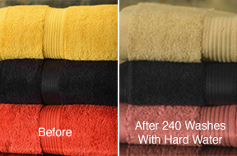
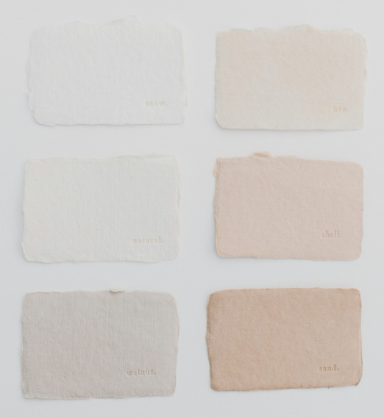
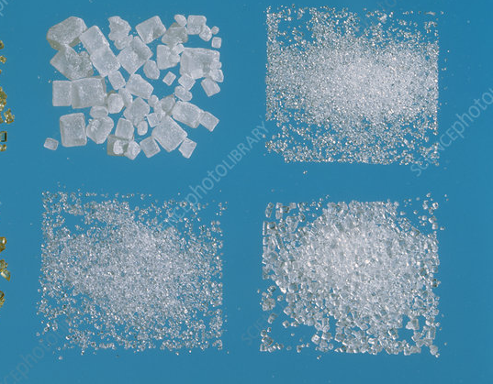
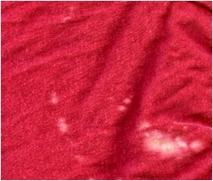
(c) Sugar Industry: Water containing sulphates, carbonates, nitrates affects the crystallisation of sugar.
(d) Pharmaceutical Industry: Hard water may form some undesirable products while preparation of pharmaceutical products.

Slide 9
(iii) STEAM GENERATION IN BOILERS: For steam generation, boilers are employed. If hard water is used in boilers, It may lead to the following troubles-
Boiler Corrosion
Scale and Sludge formation.
Priming and Foaming
Caustic embrittlement Pharmaceutical industry

Slide 10
HARDNESS OF WATER (OR) HARDWATER AND SOFT WATER:
Hard Water: The water which does not produce lather (or) very little lather with soap is called Hard Water.
Soft Water: Soft water readily produces a lot of lather when mixed with little soap.
The Hardness of water is caused by the presence of dissolved salts such as Bicarbonates, Sulphates, Chlorides and Nitrates of bivalent metal ions like Ca⁺² & Mg⁺².

Slide 11
Soap is sodium/ potassium salt of higher fatty acids like stearic, oleic and palmetic acids. When soap is mixed with soft water lather is produced due to stearic acid and sodium stearate.
Na – Stearate + H₂O → NaOH + Stearic Acid
[C₁₇H₃₅COOH]
Stearic Acid + Na-Stearate → Formation of lather.

Slide 12
When soap comes in contact with HARD WATER, Sodium stearate will react with dissolved calcium and magnesium salts and produce calcium stearate or magnesium stearate which is white precipitate.
2Na– Stearate + Ca⁺² → Ca– Stearate↓ + 2Na⁺
[2C₁₇H₃₅COONa] + Ca⁺² → [(C₁₇H₃₅COO)₂Ca]↓ + 2Na⁺ (Soap) (Soluble) (Insoluble) (Soluble)
[2C₁₇H₃₅COONa] + Mg⁺² → [(C₁₇H₃₅COO)₂Mg]↓ + 2Na⁺ (Soluble) (Soluble) (Insoluble) (Soluble)

Slide 13
TYPES OF HARDNESS
The hardness of water is of two types-
Temporary hardness (or) Carbonate hardness
Permanent hardness (or) Non-Carbonate hardness
(1) Temporary Hardness: Temporary hardness is caused by two dissolved bicarbonate salts Ca(HCO₃)₂ and Mg(HCO₃)₂. The hardness is called “Temporary Hardness” because it can be removed easily by means of boiling.
Ca(HCO₃)₂ + Heating → CaCO₃↓ + H₂O + CO₂↑ Mg(HCO₃)₂ + Heating → Mg(OH)₂↓ + 2CO₂↑

Slide 14
(2) Permanent Hardness: Permanent hardness of water is due to the dissolved chlorides, sulphates and nitrates of calcium and magnesium. These salts are CaCl₂, CaSO₄, Ca(NO₃)₂, MgCl_{2,} MgSO₄, Mg(NO₃)_{2.} These hardness cannot be removed easily by boiling. Hence it is called “Permanent Hardness”. Only chemical treatment can remove this hardness.
Total Hardness Of Water = Temporary Hardness + Permanent Hardness

Slide 15
DEGREE OF HARDNESS:
• The Concentration of hardness as well as non-hardness constituting ions are, usually expressed in the term of “Equivalent amount of CaCO₃”
• Since this mode permits the multiplication and division concentration, when required.
• The choice of CaCO₃ in particular is due to its molecular weight (m.wt.) is “100” (Equivalent wt. = 50), and
• Moreover, it is insoluble salt that can be precipitated in water treatment.

Slide 16
Therefore, 100 parts by weight of CaCO₃ hardness must be equivalent to-
162 parts by weight of Ca(HCO₃)₂ hardness
146 parts by weight of Mg(HCO₃)₂ hardness
136 parts by weight of CaSO₄ hardness
111 parts by weight of CaCl₂ hardness
164 parts by weight of Ca(NO₃)₂ hardness
120 parts by weight of MgSO₄ hardness
95 parts by weight of MgCl₂ hardness
148 parts by weight of Mg(NO₃)₂ hardness

Slide 17
Salt | Molar Mass | Chemical Equivalent | Multiplication Factor
Ca(HCO₃)₂ | 162 | 81 | 100/ 162
Mg(HCO₃)₂ | 146 | 73 | 100/ 142
CaSO₄ | 136 | 68 | 100/ 136
FeCl₂ | 127 | 63.5 | 100/ 127
CaCl₂ | 111 | 55.5 | 100/ 111
MgSO₄ | 120 | 60 | 100/ 120
MgCl₂ | 95 | 47.5 | 100/ 95
CaCO₃ | 100 | 50 | 100/ 100
MgCO₃ | 84 | 42 | 100/ 84
CO₂ | 44 | 22 | 100/ 44
Ca(NO₃)₂ | 164 | 82 | 100/164
Mg(NO₃)₂ | 148 | 74 | 100/ 148
HCO₃⁻ | 61 | 61 | 100/ 122
OH⁻ | 17 | 17 | 100/ 34
CO₃²⁻ | 60 | 30 | 100/ 60

Slide 18
Salt | Molar Mass | Chemical Equivalent | Multiplication Factor
NaAlO₂ | 82 | 82 | 100/ 164
Al₂(SO₄)₃ | 342 | 57 | 100/ 114
FeSO₄.7H₂O | 278 | 139 | 100/ 278
H⁺ | 1 | 1 | 100/ 2
HCl | 36.5 | 36.5 | 100/ 73
The method of calculating degree of hardness is given by the following formula
•Hardness causing salt in terms of equivalent of CaCO₃= (Amount (Mass) of the hardness causing salt x 100)/ Molecular weight of hardness causing salt

Slide 19
UNITS OF HARDNESS:
The 5 different units in which the hardness of water is expressed as given below-
(1) Parts per million (PPM): PPM is the number of parts of CaCO₃ equivalent hardness per 10⁶ parts of water.
i.e., 1 PPM = 1 part of CaCO₃ equivalent hardness in 10⁶ parts of water.

Slide 20
(2) Milli grams Per Litre (mg/litre): mg/L is the number of milligrams of CaCO₃ equivalent hardness present per litre of water.
i.e., 1 mg/L = 1 mg of CaCO₃ equivalent hardness in 1L of water.
But 1 L water weighs = 1 kg of water
1 kg = 1000 gms = 1000 x 1000 mg = 10⁶ mg
∴ 1 mg/L = 1mg of CaCO₃ equivalent per 10⁶ mg of water
= 1 part of CaCO₃ equivalent per 10⁶ parts of water
∴ 1 mg/L = 1 ppm

Slide 21
(3) Degree Of Clarke (ºCl): It is number of grains (1/7000 lb) of CaCO₃ equivalent hardness per gallon (10 lb) of water.
(or) It is defined as the number of parts of CaCO₃ equivalent hardness per 70,000 parts of water.
∴ 1 ºCl = 1 grain of CaCO₃ eq. hardness per gallon of water.
(or) 1 ºCl = 1 part of CaCO₃ eq. hardness per 70,000 parts of water
∴ 1 ppm = 0.07 ºCl

Slide 22
(4) Degree Of French (ºFr): It is the number of parts of CaCO₃ equivalent hardness per 10⁵ parts of water.
1 ºFr = 1 part of CaCO₃ equivalent hardness per 10⁵ parts of water
∴ 0.1 ºFr = 1 ppm
Note: The hardness of water can be converted into all the four units by making use of the following interconversion formula-
1 ppm = 1mg/L = 0.07ºCl = 0.1ºFr
1 ºCl = 1.43ºFr = 14.3 ppm = 14.3 mg/L

Slide 23
(5) Milliequivalent per Litre (meq/L): It is the number of milliequivalent of hardness present per litre of water.
1 meq/L= 1 meq of CaCO₃ per litre of water
= 10⁻³ x 50 g of CaCO₃ eq. of hardness per litre of water
= 50 mg of CaCO₃ eq. of hardness per litre of water
= 50 mg/L of CaCO₃ eq.
= 50 ppm
∴1 meq/L= 50 ppm

Slide 24
Convert the total hardness of water samples in ppm and meq/L from the following:
A. 20.23ºCl; B. 31.8ºFr
Solution;
A. 1ppm= 0.07deg Cl and 1 deg Cl= 14.3 ppm
20.23 deg Cl= 14.3 x 20.23= 289.3ppm
1meq/L= 0.35 deg Cl and 1 deg Cl= 0.286 meq/L
20.23 deg Cl= 0.286 x 20.23 = 5.79 meq/L
B. 1ppm= 0.1 deg Fr and 1 deg Fr= 10ppm
31.8 deg Fr= 10 x 31.8 = 318 ppm
1meq/L = 5 deg Fr and 1 deg Fr= 0.2 meq/L
31.8 deg Fr= 0.2 x 31.8 = 6.36 meq/ L

Slide 25
A sample of water has hardness 208ppm CaCO₃ eq. Find the hardness in terms of mg/L, ºFr, ºCl, meq/L.
Solution:
208ppm= 208mg/L
208ppm= 20.8degFr
208ppm= 14.56degCl
208ppm= 4.16meq/L
How many grams of FeSO₄ dissolved per litre gives 210.5ppm of hardness?
Solution: M. wt. of FeSO₄= 152; M. wt. of CaCO₃= 100
FeSO₄ >>> CaCO₃
152 >>>>>> 100
100ppm hardness >>>> 152 ppm of FeSO₄
So, 210.5 ppm hardness= 152 x 210.5 ÷ 100= 319.96ppm of FeSO₄
Thus, 0.319g of FeSO₄ dissolved per litre gives 210.5ppm of hardness

Slide 26
Three samples were analysed for their salt content:
Sample A contains 168mg of magnesium carbonate per litre
Sample B contains 820mg of calcium nitrate and 2mg of silica per litre
Sample C contains 20g potassium nitrate and 2g calcium carbonate per 500ml
Determine the hardness in ppm and grains per gallon.
Solution:
Thus, Hardness is- (1ppm= 0.07degCl= 0.07 grains/ gallon)
Sample A= 200ppm= 200 x 0.07 = 14 grains/ gallon
Sample B= 500ppm= 35 grains/ gallon
Sample C= 4000ppm= 280 grains/ gallon
Sample | Constituent mg/L | M.Wt. | Multiplication Factor | CaCO₃ eq mg/L
A | MgCO₃= 168 | 84 | 168 x 100 ÷ 84 | 200
B | Ca(NO₃)₂= 820 | 164 | 820 x 100 ÷ 164 | 500
C | CaCO₃= 2g/500ml= 4000 | 100 | 4000 x 100 ÷ 100 | 4000

Slide 27
Classify the following into temporary, permanent and non-hardness causing impurities:
Ca(HCO₃)₂, MgSO₄, CaCl₂, CO₂, HCl, Mg(HCO₃)₂, CaSO₄, NaCl.
How many grams of CaCl₂ dissolved per litre gives 150ppm of hardness?
Solution:
CaCO₃ + HCl à CaCl₂ + H₂O + CO₂
100 111
1gm 1.11gm
So, 150gms of CaCO₃= 150 x 1.11= 166.5gms of CaCl₂
Thus, 166.5gm of CaCl₂ dissolved in 1L water gives 150ppm hardness
Temporary Hardness | Permanent Hardness | Non-Hardness
Ca(HCO₃)₂, | MgSO₄, | NaCl.
Mg(HCO₃)₂, | CaCl₂, | CO₂,
 | CaSO₄ | HCl,

Slide 28
PROBLEM:
A sample of water gives an analysis 13.6 mg/L of CaSO₄ , 7.3 mg/L of Mg(HCO₃)₂ . Calculate the total hardness and permanent hardness.
Sol:
Total hardness= Temporary hardness + Permanent Hardness = 5 + 10 = 15 mg/L = 15 ppm
Permanent hardness = 10 ppm
Temporary hardness= 5 ppm
Salt | Quantity (mg/L) | M. Wt. | Multiplication Factor | Eq. of CaCO₃ | Hardness
CaSO₄ | 13.6 | 136 | 100/ 136 | 13.6 x (100/ 136)= 10 | P
Mg(HCO₃)₂ | 7.3 | 146 | 100/ 146 | 7.3 x (100/ 146)= 5 | T

Slide 29
DETERMINATION OF HARDNESS OF WATER BY EDTA METHOD:-
This is a Complexometric titration method where Ethylenediamine tetraacetic acid (EDTA) is used.
EDTA forms complexes with different metal ions at different pH.
Calcium & Magnesium ions form complexes with EDTA at pH 9- 10.
To maintain the pH 9- 10 NH₄Cl, NH₄OH buffer solution is used.

Slide 30
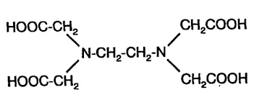
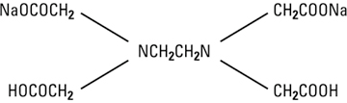
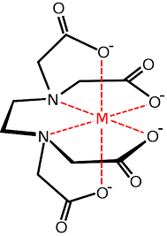
4. The disodium salt of EDTA is used for complexation.
5. An alcoholic solution of Eriochrome Black-T (EBT) is used as an indicator.
EDTA
EDTA disodium salt
Metal-EDTA complex

Slide 31
BASIC PRINCIPLE:
When hard water comes in contact with EDTA, at pH 9- 10, the Ca⁺² & Mg⁺² forms stable, colourless complex with EDTA.
Ca⁺² + EDTA + pH 9-10 → Ca-EDTA
Mg⁺² + EDTA + pH 9-10 → Mg-EDTA

Slide 32
Working:-
To the hard water sample, the alcoholic blue coloured EBT indicator is added along with the NH₄Cl + NH₄OH buffer (pH 9- 10) solution.
EBT forms an unstable wine-red complex with Ca⁺² & Mg⁺².
(Ca⁺² + Mg⁺²) + EBT + Buffer (pH 9-10) → (Ca-EBT + Mg-EBT) complex
(Hard water) (Indicator) (Unstable wine-red complex)
This wine-red coloured [Ca-EBT & Mg-EBT] complex is then titrated against EDTA; when EDTA replaces EBT from Ca-EBT & Mg-EBT complex and forms stable colourless [Ca-EDTA] & [Mg-EDTA] complex releasing the blue coloured indicator EBT into H₂O.
[Ca-EBT + Mg-EBT] complex + EDTA → EBT + [Ca-EDTA + Mg-EDTA] complex
(Unstable wine-red complex) (Blue) (Stable colourless complex)
Hence the colour change at the end point is wine-red to blue colour.

Slide 33
The titration is carried out in the following steps 1. PREPARATION OF STANDARD HARD WATER: Dissolve 1gm of pure, dry CaCO₃ in minimum quantity of dilute HCl and evaporate the solution to dryness on a water-bath. Dissolve the residue in distilled water to make 1 litre in a standard flask and shake well.
Molarity of standard hard water solution =
wt. of CaCO₃ = 1 = 0.01M
M.wt. of CaCO₃ 100

Slide 34
(2) PREPARATION OF EDTA SOLUTION:
Dissolve 4 gms of pure EDTA-disodium salt crystals along with 0.1 gm of MgCl₂ in one litre of distilled water.
(3) PREPARATION OF INDICATOR (EBT):
Dissolve 0.5 gms of Erichrome Black-T in 100 ml of alcohol.
(4) PREPARATION OF BUFFER SOLUTION: Add 67.5 gm of NH₄Cl to 570 ml of concentrated ammonia solution and dilute with distilled water to one litre

Slide 35
(5) STANDARDISATION OF EDTA SOLUTION: Pipette out 20 ml of standard hard water solution into a conical flask. Add 2- 3 ml of buffer (pH 9- 10) solution and 2- 3 drops of EBT indicator. Titrate the wine-red coloured complex with EDTA taken in a burette after rinsing it with EDTA solution till the wine red colour changes to clear blue.
Note the burette reading and let the volume be “x”ml. Repeat the titration to get concurrent values.

Slide 36
(6) TITRATION OF SAMPLE HARD WATER (Total) :
Pipette out 20 ml of the water sample into a 250ml conical flask, add 2- 3 ml of buffer (pH 9- 10) solution and 2- 3 drops of EBT indicator. Titrate the wine-red coloured solution with EDTA taken in the burette till a clear blue coloured end point is obtained.
Let the volume of EDTA be “y” ml. Repeat the titration to get concurrent values

Slide 37
(7) TITRATION FOR PERMANENT HARDNESS:
Pipette out 100 ml of hard water sample in a beaker and boil till the volume reduces to 20 ml. All the bicarbonates of Ca⁺⁺ and Mg⁺⁺ decomposes to CaCO₃ and Mg(OH)₂. Cool the solution and filter the water into a flask, wash the beaker and precipitate with distilled water and add the washing to conical flask. Add 2- 3 ml of buffer (pH 9- 10) solution and 2- 3 drops of EBT indicator and titrate with EDTA solution taken in the burette till a clear blue colour end point is obtained.
Note the burette reading. Let the volume be “z” ml.

Slide 38
CALCULATIONS:
Molarity of standard hard water solution = 0.01 M.
(Calculated in the preparation of standard hard water)
Molarity of EDTA solution (M2 ): V₁M₁ = V₂M₂
n₁ n₂
n₁ & n₂ are no. of moles of Ca⁺² and EDTA = 1 each
i.e., n₁=1, n₂=1
V₁ = volume of standard hard water
M₁= Molarity of standard hard water
V₂= volume of EDTA
M₂= molarity of EDTA
M₂ = V₁M₁ = 20 X 0.01
V₂ x (titre value)

Slide 39
Molarity of sample hard water (M₃ ):
V₂M₂ = V₃M₃
n₂ n₃
V₂= volume of EDTA
M₂= molarity of EDTA
V₃= volume of sample hard water
M₃= Molarity of sample hard water
M₃ = V₂M₂ = M₂ x y (titre value)= y x 0.01
V₃ 20 x
Total Hardness Of Water
= M₃ x 100 gms/1 litre
=M₃ X 100 X 1000mg/L or ppm= (y/ x) X 1000ppm

Slide 40
Permanent Hardness Of Water:
V₂M₂ = V₄M₄ M₄= V₂M₂ = zM₂ = z X 0.01
n₂ n₄ V₄ 20 x
V₂= volume of EDTA
M₂= molarity of EDTA
V₄ = volume of water sample containing permanent hardness (100 ml)
M₄= Molarity of water sample containing permanent hardness
Permanent Hardness Of The Water Sample
= M₄ x 100 x 1000 ppm
= z/ x X 1000ppm

Slide 41
Temporary Hardness Of The Water Sample
= (Total Hardness – Permanent Hardness)
= (M₃ x 100 x1000 – M₄ x 100 x1000) ppm
= (M₃ – M₄) x 100 x1000 ppm
= (y-z) X 1000 ppm
x

Slide 42
Alternate:
20ml SHW = x ml EDTA; i.e, 20 x 1 mg of CaCO3 = x ml of EDTA
So, 1 ml EDTA = 20/x mg of CaCO3
Now, 20 ml HW = y ml EDTA
But, 1 ml EDTA = 20/x mg CaCO3; So, y ml EDTA = 20y/x mg of CaCO3
Thus, 20 ml HW = 20y/x mg of CaCO3
So, 1000 ml HW = 1000 x (20y/x) x (1/20) = 1000y/x mg of CaCO3
Thus, Total hardness = 1000y/x ppm
Next, 20 ml boiled water = z ml EDTA
But, 1 ml EDTA = 20/x mg CaCO3; So, z ml EDTA = 20z/x mg of CaCO3
Thus, 20 ml boiled W = 20z/x mg of CaCO3
So, 1000 ml boiled W = 1000 x (20z/x) x (1/20) = 1000z/x mg of CaCO3
Thus, Permanent hardness = 1000y/x ppm
Temporary hardness = Total hardness – Permanent hardness
= [1000(y/x)] – [1000(z/x)]
= 1000 [(y-z)/x] ppm

Slide 43
Problem:
1 gm of CaCO₃ was dissolved in HCl and the solution was made upto 1 Lit with distilled water. 50 ml of the above solution required 30 ml of EDTA solution for titration. 50 ml of hard water sample required 40 ml of the same solution of EDTA for titration. 50 ml of the hard water after boiling, filtering, etc. required 30 ml of the same EDTA solution for titration. Calculate the temporary hardness of the water.

Slide 44
Soln:
Molarity of CaCO₃ (SHW) solution (M₁)= 1/100= 0.01 M Molarity of EDTA solution (M₂ ) = V₁ M₁/ V₂
V₁= volume of CaCO₃ solution = 50 ml
M₁= Molarity of CaCO₃ solution = 0.01 M
V₂= volume of EDTA = 30 ml
M₂= 50 x 0.01/ 30 = 0.016 M
Molarity of Hard Water Sample Sol.(M₃ )= V₂M₂/ V₃
V₂= volume of EDTA = 40 ml
M₂= Molarity of EDTA = 0.016 M
V₃= volume of hard water sample= 50 ml
M₃= 40 x 0.016/ 50 = 0.0128 M

Slide 45
Total Hardness of water
= 0.0128 x 100 x 1000
= 1280 ppm
Permanent hardness of water: = V₄ M₄ = V₂ M₂
n₄ n₂
M₄ = V₂M₂/ V₄
n₄=1; V₂= volume of EDTA = 30 ml
n₂=1; M₂= molarity of EDTA = 0.016
V₄= volume of permanent hardness containing water = 50
M₄ = 30 x 0.016/ 50= 0.0096 M

Slide 46
Permanent hardness of water
= 0.0096 x 100 x 1000 = 960 ppm
Temporary hardness
= Total hardness – Permanent hardness
= 1280 – 960 = 320 ppm

Slide 47
20ml of SHW containing 1.2gm CaCO3 per litre required 35ml of EDTA. 50ml of hard water sample required 30ml of same EDTA. 100ml of hard water sample after boiling, cooling required 25ml of same EDTA. Calculate the hardness.
Solution: Strength of SHW= 1.2gm/ lit = 1200mg/ lit = 1.2mg/ ml
Volume of SHW= 20ml = 20 x 1.2 = 24mg of CaCO3 equiv hardness
Now, 20ml SHW = 35ml EDTA = 24mg of CaCO3 equiv hardness
i.e. 35ml EDTA = 24mg So, 1 ml EDTA= 24/35 mg CaCO3 hardness
50ml sample water = 30ml EDTA = 30 x 24/35 mg CaCO3 hardness = 20.57mg
Thus, 1 lit = 1000ml = 1000 x 20.57/50 = 411.4mg
So, Total hardness = 411.40ppm
100ml of boiled sample= 25ml EDTA = 25 x 24/35 = 17.14mg CaCO3 hardness
Thus, 1 lit = 1000ml = 1000 x 17.14/100 = 171.4mg
So, Permanent hardness = 171.40ppm
Temporary Hardness = Total hardness – Permanent hardness
411.40 – 171.40 = 240.00ppm

Slide 48
BOILER TROUBLES:
Water finds a great use in various industries for generation of steam in boilers. When water is continuously evaporated to generate steam, the concentration of the dissolved salts increase progressively causing bad effects for steam boilers. The following are the boiler troubles that arise:
Priming and foaming
Caustic embrittlement
Boiler corrosion
Scale and sludge formation

Slide 49
PRIMING & FOAMING:
Priming: When a boiler is steaming rapidly, some particles of the liquid water are carried along with the steam. This process of “WET STEAM” formation is called ‘PRIMING’. Priming is caused by:
Presence of large amount of dissolved solids
High steam velocities
Sudden boiling
Improper boiler design
Sudden increase in steam production rate

Slide 50
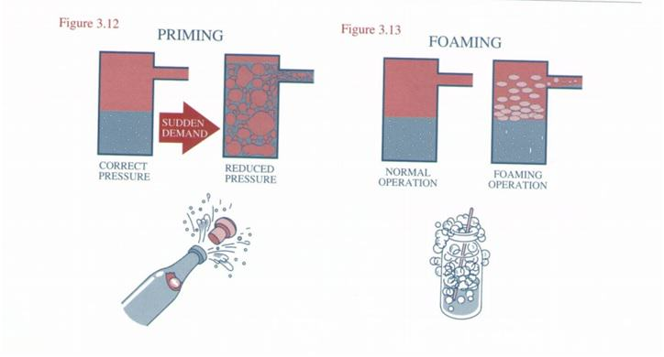
It can be avoided by: (Preventions)
Maintaining low water level
Using softened water
Fitting mechanical steam purifiers
Using a well-designed boiler
Avoiding rapid change in steam rate
Blow-down of the boiler

Slide 51
FOAMING:
Foaming is phenomenon of formation of foam or bubbles on the surface of water inside the boiler with the result that the foam may pass along with the steam.
Causes: The presence of large quantity of suspended impurities and oils lowers the surface tension producing foam.
Preventions: Foaming can be avoided by-
Adding anti foaming chemicals like castor oil
Removing oil from boiler water by adding compounds like “NaAlO₂ ”
Blow down of the boiler can prevent the foaming

Slide 52
Disadvantages Of Priming & Foaming:
Priming & Foaming may cause the following boiler troubles:-
The actual height of the water in boiler is not judged
Wastage of heat with the result that it becomes difficult to keep up steam pressure and efficiency of the boiler is lowered

Slide 53
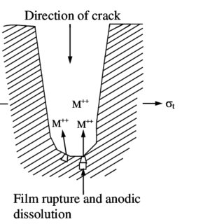
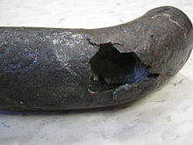
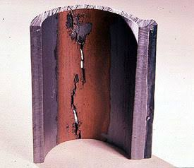
CAUSTIC EMBRITTLEMENT:
Caustic embrittlement is a term used for the appearance of cracks inside the boiler particularly at those places which are under stress such as rivetted joints due to the high concentration of alkali leading to the failure of the boiler. The cracks have appearance of brittle fracture. Hence, the failure is called “Caustic Embrittlement”

Slide 54
Reasons for the formation of Caustic Embrittlement:
The boiler feed water containing carbonates and bicarbonates of alkali metals, sodium hydroxide (NaOH) and a small quantity of silica or sodium silicate; it is purified by Lime-Soda Process.
During the softening process by lime soda process, free Na₂CO₃ is usually present in small portion in the soft water which decomposes to give NaOH and CO₂ at high pressure of the boilers.
Na₂CO₃ + H₂O → 2NaOH + CO₂
The precipitation of NaOH makes the boiler water “Caustic”
The NaOH containing water flows into the small pits and minute haircracks present on the inner walls of the boiler.
As the water evaporates, the concentration of caustic soda (NaOH) increases progressively, creating a “Concentration Cell”

Slide 55
Thus, dissolving the iron of the boiler as Sodium Ferrate.
Fe + 2NaOH → Na₂FeO₂ + H₂
The cracking of the boiler occurs particularly at stressed parts like bends, joints, rivets, etc. causing the failure of the boiler.
The iron at plane surfaces surrounded by dilute NaOH becomes Cathodic; while the Iron at bends, rivets and joints is surrounded by highly concentrated NaOH becomes Anodic which consequently decayed or corroded
(Anodic site) Conc NaoH || dil NaoH (Cathodic site)
Iron at Joints &bends Iron at Plane surface
Prevention Of Caustic Embrittlement:
By adding Na₂SO₄ , tannin, etc. to the boiler water which blocks hair cracks. There by preventing infiltration of caustic soda solution
By using sodium phosphate as the softening agent instead of sodium carbonate

Slide 56
DISADVANTAGES OF CAUSTIC EMBRITLLEMENT:
The cracking or weakening of the boiler metal causes failure of the boiler
(3) BOILER CORROSION: The decay of boiler material by chemical/ electro- chemical attack by its environment is called “Boiler Corrosion”.
Reasons for boiler corrosion are: (a) Dissolved oxygen (b) Dissolved CO₂ (c) Acids from dissolved salts.

Slide 57
Dissolved Oxygen: Water usually contains about 8 mg/L of dissolved oxygen at room temperature. Dissolved O₂ at high temperature attacks boiler material.
2Fe + 2H₂O + O₂ → 2Fe(OH)₂↓ (ferrous hydroxide)
4Fe(OH)₂↓ + O₂ → 2[Fe₂O₃.2H₂O]↓ (ferric oxide) Removal of dissolved O₂ :
By adding calculated quantity of sodium sulphate (or) hydrazine (or) sodium sulphide
2Na₂SO₃ + O₂ → 2Na₂SO₄
Sodium Sulphite
N₂H₄ + O₂ → N₂ + 2H₂O
Hydrazine
Na₂S + 2O₂ → Na₂SO₄

Slide 58
(b) Dissolved CO₂:
Dissolved CO₂ has slow corrosive effect on the materials of boiler plate. Source of CO₂ into water is the boiler feed water which contains bicarbonates. Under the high temperature and pressure, maintained in the boiler the bicarbonates decompose to produce CO₂.
Ca(HCO₃ )₂ → CaCO₃ + CO₂ ↑ + H₂O
Mg(HCO₃ )₂ → Mg(OH)₂ + 2CO₂ ↑
The disadvantage of the CO₂ is slow corrosive effect on boiler plates by producing carbonic acid
CO₂ + H₂O → H₂CO₃

Slide 59
Removal of CO₂:
By the addition of calculated quantity of ammonia.
2NH₄OH + CO₂ → (NH₄ )₂CO₃ + H₂O
(c) Acids from dissolved salts:
Water containing dissolved Mg-salts liberate acids on hydrolysis
MgCl₂ + 2H₂O → Mg(OH)₂↓ + 2HCl
Disadvantages of the acid production is that the acids react with Iron of the boiler plate in a chain reaction to produce decay of the metal.
Fe + 2HCl → FeCl₂ + H₂
FeCl₂ + H₂O → Fe(OH)₂ + 2HCl
Fe(OH)₂ + H₂O + 1/2O₂ → Fe₂O₃ .3H₂O (ferric oxide)

Slide 60
Consequently even a small amount of MgCl₂ can cause corrosion to a large extent.
Preventions:
Softening of boiler water to remove MgCl₂ from the water
Addition of corrosion inhibitors like sodium silicates, sodium phosphate & sodium chromate
By frequent blow-down operation i.e., removal of water, concentrated with dissolved salts and feeding the boiler with fresh soft water.
Sludges and Scales formation: In boiler, water evaporates continuously and the concentration reaches saturation point, they form precipitates (scale or sludge) on the inner wall of the boiler

Slide 61
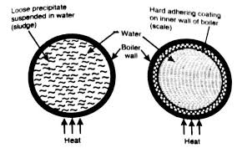
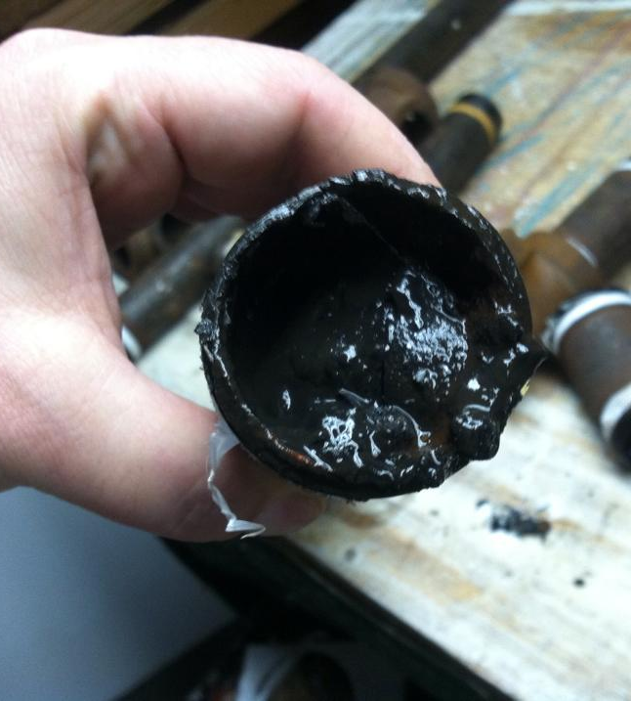
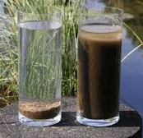
SLUDGE: “Sludge is a soft, loose and slimy precipitate formed within the boiler”. Sludge are formed by substances which have greater solubility in hot water than in cold water. Salts like MgCO₃ , MgSO₄ , MgCl₂ , CaCl₂ etc., are responsible for sludge formation in boilers.
Disadvantages:
Sludge is a bad conductor of heat, hence it wastes a portion of heat generated.
Excessive sludge formation reduces the efficiency of the boiler.

Slide 62
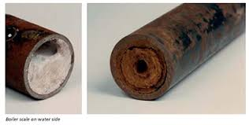
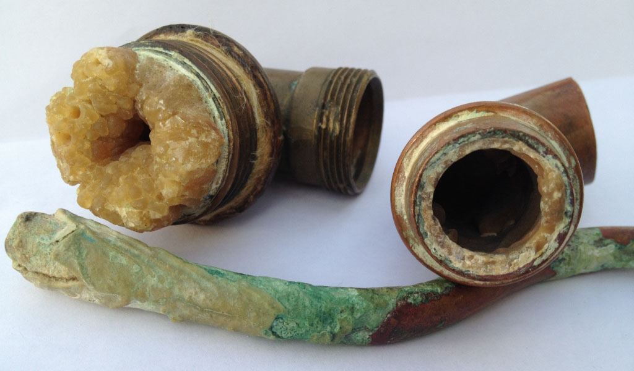
Prevention:
(a) Frequent blow-down operation should be carried out.
(b) Use well-softened water.
SCALES: “Scales are the hard, adhering ppt formed on the inner wall of the boiler”. Very difficult to remove once they are deposited on Inner wall of the boiler.
They formed due to decomposition of Calcium bicarbonate, Calcium sulphate etc..,
Ca(HCO₃)₂ → CaCO₃ ↓ + H₂O + CO₂ ↑

Slide 63
REMOVAL OF SCALES:
Frequent blow-down operation can remove the scales which are loosely adhering.
By chemical treatment eg: CaCO₃ scale removed by washing with 5-10% of HCl.
By giving thermal shocks.
Prevention: Use soft water.

Slide 64
SOFTENING OF WATER:
The removal of hardness causing salts from water is called “Softening of water”.
The 3 Industrial methods employed for softening of water are:
Lime-Soda Process
Zeolite (or) Permutite Process
Ion-Exchange (or) Demineralization process

Slide 65
LIME-SODA PROCESS:
This process is based on converting the soluble calcium and magnesium salts into Insoluble calcium carbonate and magnesium hydroxide precipitates by addition of calculated amount of lime (Ca(OH)₂) and Soda (Na₂CO₃). The precipitate are removed by filtration. Any free dissolved CO₂ and acids are also removed by this process. The various chemical reactions involved in this process are:

Slide 66
For Calcium and Magnesium bicarbonates, only lime is required
Ca(HCO₃)₂ + Ca(OH)₂ → 2CaCO₃↓ + 2H₂O
Mg(HCO₃)₂ + 2Ca(OH)₂ → 2CaCO₃↓ + Mg(OH)₂↓ + 2H₂O
(b) For MgSO₄ & MgCl₂ , both lime & soda are required
(iii) MgSO₄ + Na₂CO₃ + Ca(OH)₂ → Mg(OH)₂↓ + CaCO₃↓ + Na₂SO₄
(iv) MgCl₂ + Na₂CO₃ + Ca(OH)₂ → Mg(OH₂)↓ + CaCO₃ + 2NaCl
(c) For CaSO₄ & CaCl₂, only Soda is required
(v) CaSO₄ + Na₂CO₃ → CaCO₃↓ + Na₂SO₄
(vi) CaCl₂ + Na₂CO₃ → CaCO₃↓ + 2NaCl

Slide 67
(d) Other Reactions: Free acids, CO2 , H2S dissolved iron and aluminium salts etc are also removed in this process
2HCl + Na₂CO₃ → 2NaCl + H₂O + CO₂↑
H₂SO₄ + Na₂CO₃ → Na₂SO₄ + H₂O + CO₂↑
CO₂ + Ca(OH)₂ → CaCO₃↓ + H₂O
H₂S + Ca(OH)₂ → CaS↓ + 2H₂O
FeSO₄ + Ca(OH)₂ → Fe(OH)₂↓ + CaSO₄
Al₂(SO₄)₃ + 3Ca(OH)₂ → 2Al(OH)₃↓ + 3CaSO₄ + H₂O

Slide 68
Constituent | Reaction | Requirement
Ca⁺² (Permanent) | CaSO₄ + Na₂CO₃ → CaCO₃↓ + Na₂SO₄ CaCl₂ + Na₂CO₃ → CaCO₃↓ + 2NaCl | S
Mg⁺² (Permanent) | (iii) MgSO₄ + Na₂CO₃ + Ca(OH)₂ → Mg(OH)₂ ↓ + CaCO₃↓ + Na₂SO₄ (iv) MgCl₂ + Na₂CO₃ + Ca(OH)₂ → Mg(OH₂ ) ↓ + CaCO₃ + 2NaCl | L + S
HCO3⁻ | (v) 2NaHCO₃ + Ca(OH)₂ → CaCO₃ + H₂O + Na₂CO₃ | L - S
Ca(HCO₃)₂ (Temporary) | (vi) Ca(HCO₃ )₂ + Ca(OH)₂ → 2CaCO₃↓ + 2H₂O | L
Mg(HCO₃)₂ (Temporary) | (vii) Mg(HCO₃)₂ + 2Ca(OH)₂ → 2CaCO₃↓ + Mg(OH)₂↓ + 2H₂O | 2L
CO₂ | (viii) CO₂ + Ca(OH)₂ → CaCO₃↓ + H₂O | L
H⁺ | (ix) 2HCl + Ca(OH)₂ + Na₂CO₃ → CaCO₃ + 2NaCl + H₂O | L + S
Coagulants FeSO₄ | (x) FeSO₄ + Ca(OH)₂ → Fe(OH)₂ + CaSO₄ 2Fe(OH)₂ + H₂O + O₂→ 2Fe(OH)₃ CaSO₄ + Na₂CO₃ → CaCO₃ + Na₂SO₄ | L + S
Al₂(SO₄)₃ | (xi) Al₂(SO₄ )₃ + 3Ca(OH)₂ → 2Al(OH)₃↓ + 3CaSO₄ + H₂O 3CaSO₄ + 3Na₂CO₃ → 3CaCO₃ + 3Na₂SO₄ | L + S
NaAlO₂ | (xii) NaAlO₂ + H₂O → Al(OH)₃ + NaOH | -L

Slide 69
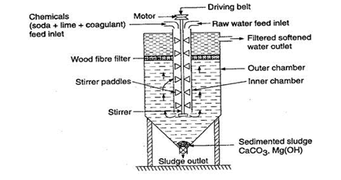
COLD-LIME-SODA PROCESS:

Slide 70
In this method the lime & soda are mixed with hard water at room temperature with constant stirring.
Generally the precipitates formed by this process are finely divided and in order to settle the precipitates, coagulants like alum, ferrous sulphate, etc. are added.
The hard water to be softened is mixed with calculated quantity of chemicals (Lime + Soda + Coagulant) from the top into the inner chamber on vigorous stirring. The chemical reactions takes place and the hardness producing salts get converted into insoluble precipitates.
The sludge is removed from the bottom of the outer chamber while the softened water passes through a wood fibre filter to ensure the complete removal of any residual sludge particles.
The clear softened water is withdrawn from the top of the outer chamber.
The softened water from this process contains a residual hardness of 50-60ppm

Slide 71
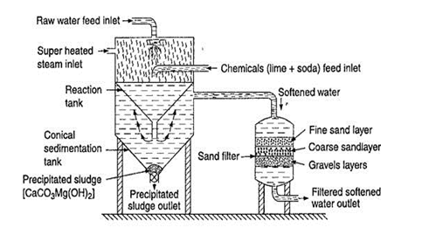
HOT-LIME-SODA PROCESS:

Slide 72
This process is similar to the cold lime-soda process, but no coagulant is needed.
Here the process is carried at a temperature of 80º to 150ºC. Since the reaction carried out at high temperature.
(a) The reaction takes place faster
(b) The sludge settles rapidly
(c) Viscosity of soft water is lower, hence filtered easily
(d) The dissolved gases such as CO₂, air, etc. driven out of the water
(e) The residual hardness is low, compared to cold lime- soda process.
Hot lime soda process consists of three parts-
“REACTION TANK” in which complete mixing of water, chemicals and steam takes place and water gets softened.
“Conical Sedimentation Vessel” where the sludge settle down.
“SAND FILTER” where sludge is completely removed.
The softened water from this process contains a residual hardness of 15-30 ppm.

Slide 73
ADVANTAGES OF LIME-SODA PROCESS:
This process is economical.
Mineral content of the water is reduced.
The process increases the pH value of water, which reduces the content of pathogenic bacteria.
Manganese and Iron salts are also removed by this process.
The process improves the corrosion resistance of the water.
DISADVANTAGES OF LIME-SODA PROCESS:
Due to residual hardness, water is not useful for high pressure boilers.
Large amount of sludge is formed which create disposal problem.

Slide 74
PROBLEMS:
Calculate the quantities of Lime & Soda required to soften 5000 litres of water containing the following salts: MgCl₂ = 15.5 ppm; Ca(HCO₃)₂ = 32.5 ppm, CaSO₄ = 22.4 ppm; Mg(HCO₃)₂ = 14.6 ppm; NaCl = 50 ppm
Soln: Calculation of Calcium Carbonate Equivalents:
Impurity mg/L | M. Wt. | CaCO3 eq. | Requirement
MgCl₂ = 15.5 | 95 | 15.5 x 100 ÷ 95= 16.31 | L + S
Ca(HCO₃)₂ = 32.5 | 162 | 32.5 x 100 ÷ 162= 20.06 | L
CaSO₄ = 22.4 | 136 | 22.4 x 100 ÷ 136= 16.47 | S
Mg(HCO₃)₂ = 14.6 | 146 | 14.6 x 100 ÷ 146= 10 | 2L
NaCl = 50 | -

Slide 75
100 parts by mass of CaCO₃ are equivalent to 74 parts of Ca(OH)₂ and 106 parts of Na₂CO₃.
Lime = 74/100 (Temp Ca²⁺ + 2 x Temp. Mg²⁺ + Perm. (Mg⁺² + Fe⁺² + Al³⁺) + CO₂ + H⁺ (HCl/H₂SO₄ ) + HCO₃ - all in terms of CaCO₃ equivalent) x (Vol of water/ 1000) x (100/ %P)
Lime required for litre of water:
= 74/100 (Ca(HCO₃)₂ + 2 x Mg(HCO₃)₂ + MgCl₂) x (Vol of water/ 1000) x (100/ %P) (as CaCO₃ eq.)
= 74/100 (20.06 + 2x10 + 16.31) x 5000/1000 x 100/100
= 74/100 x 56.37 x 5
= 208.55 g= 0.208 kg

Slide 76
Soda = 106/100 (Perm. (Ca²⁺ + Mg²⁺ + Fe⁺² + Al³⁺) + H⁺ (HCl/H₂SO₄) + HCO₃ - all in terms of CaCO₃ eq.) x (Vol of water/ 1000) x (100/ %P)
Soda req’d for litre of water
= 106/100 [MgCl₂ + CaSO₄] x (Vol of water/ 1000) x (100/ %P) (as CaCO₃ eq.)
= 106/100 [16.31 + 16.47]x 5000/1000 x 100/100
= 106/100 [32.78] x 5
= 173.70 gm= 0.173 kg

Slide 77
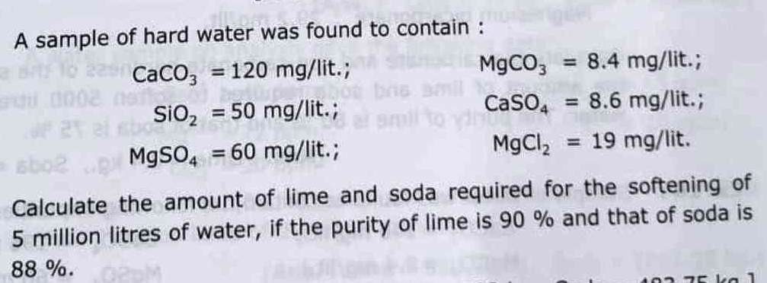

Slide 78


Slide 79
ION EXCHANGE PROCESS/ DEMINERALISATION PROCESS:
Ion exchange resins are insoluble, cross-linked, long chain organic polymers.
The functional groups attached to the chains can exchange hardness producing cations and anions present in the water.
PROCESS: The process involves the following steps:
1) The first chamber is packed with cation exchange resin (RH⁺). When the hard water is passed through a bed of cation exchange resin it exchanges H⁺ with Ca⁺², Mg⁺², K⁺, Na⁺ etc. of hard water.
2RH⁺ + Mg⁺²Cl_{2 →} R₂Mg²⁺ + 2H⁺Cl
2RH⁺ + Ca²⁺Cl_{2 →} R₂Ca²⁺ + 2H⁺Cl
Thus, the hardness producing cations (Ca²⁺, Mg²⁺ etc) are removed

Slide 80
1) The second chamber is packed with anion exchange resin. The water coming out of the first chamber contains H⁺, Cl⁻, SO₄²⁻ and HCO₃⁻ ions.
It is now passed through anion exchange resin bed which can exchange OH⁻ ions with anions like Cl⁻, SO₄²⁻ and HCO₃⁻
R-OH + Cl⁻ → RCl + OH⁻
2R-OH + SO₄²⁻ → R₂SO₄ + 2OH⁻
Thus, hardness producing anions like Cl⁻, SO₄²⁻ and HCO₃⁻ are removed.
3) Thus, H⁺ ions produced from first chamber combine with OH⁻ ions produced from second chamber to form water.
H⁺ + OH⁻ → H₂O
Hence, the water produced from ion-exchange process is completely free from all cations and anions of salts.

Slide 81
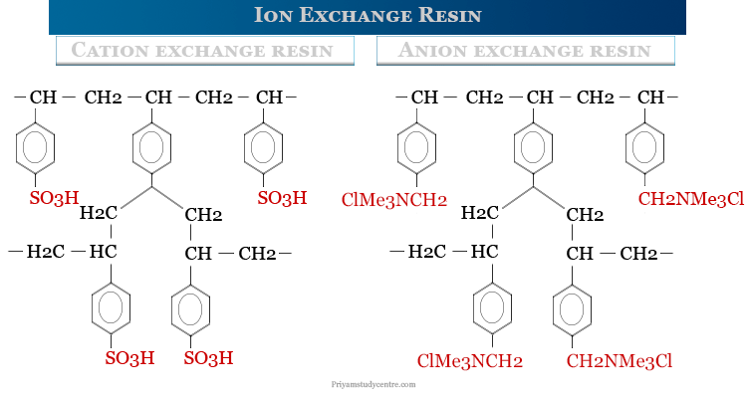
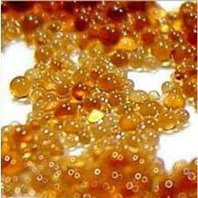

Slide 82
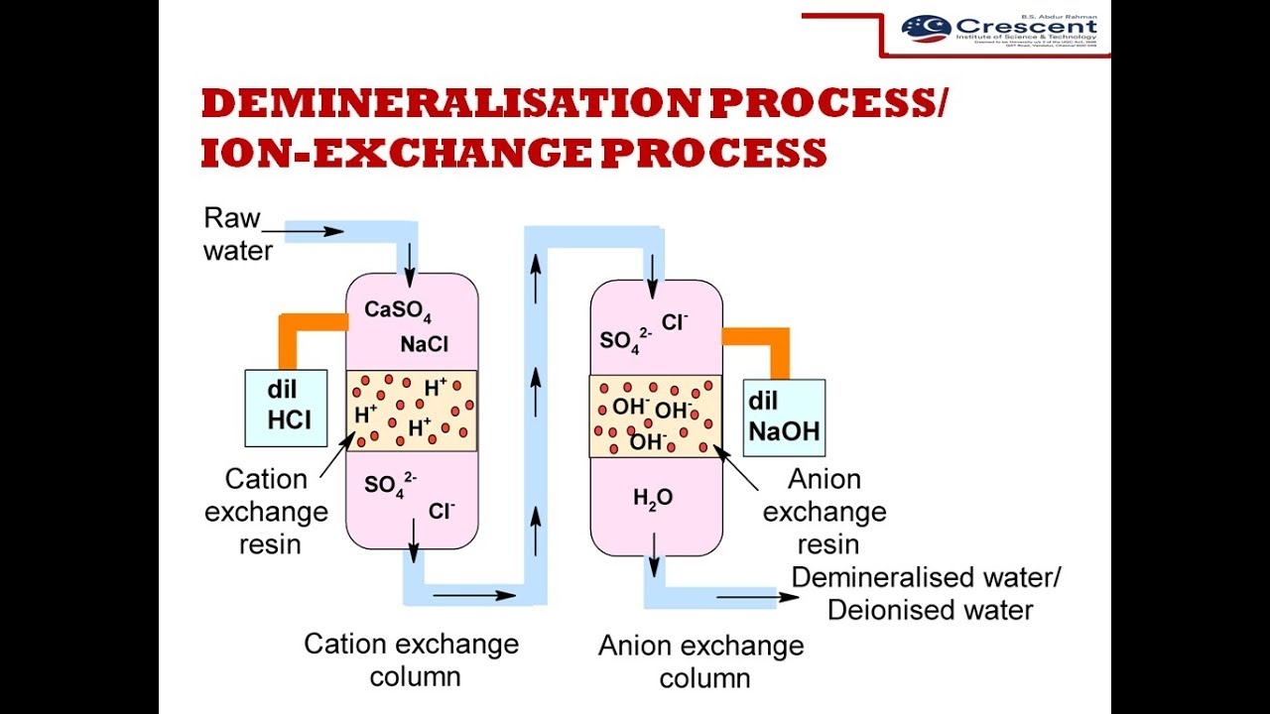

Slide 83
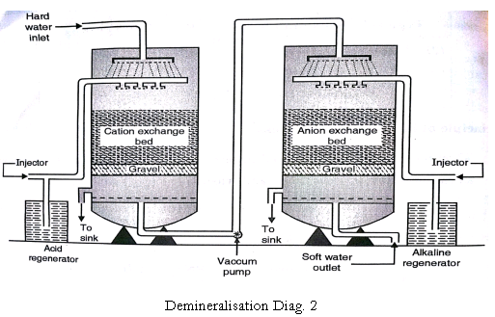

Slide 84
REGENERATION OF RESINS:
The resin bed gets exhausted, when used for a long period and can be regenerated:
(a) The exhausted cation exchange resin can be regenerated by passing dil. HCl (H⁺)
R₂Mg²⁺ + 2H⁺ → 2RH⁺ + Mg²⁺
R₂Ca²⁺ + 2H⁺ → 2RH⁺ + Ca²⁺
(b) The exhausted anion exchange resin can be regenerated by passing dil. NaOH (OH⁻)
RCl + OH⁻ → ROH + Cl⁻
R₂SO₄ + 2OH⁻ → 2ROH + SO₄²⁻

Slide 85
ADVANTAGES:
1) The softened water by this method is completely free from all salts and fit for use in boilers.
2) It produces very low hardness nearly 2 ppm.
3) Highly acidic or alkaline water can be treated by this process.
DISADVANTAGES:
1) The equipment is costly.
2) More expensive chemicals are required for regeneration.
3) Turbid water cannot be treated by this method.

Slide 86
Numerical
After treating 10⁴ litres of water by ion-exchange, the cationic resin required 200 litres of 0.1N HCl and the anionic resin required 200 litres of 0.1N NaOH solutions for regeneration. Find the hardness of water.
Solution: Hardness of 10⁴ litres of water= 200lit of 0.1N HCl
= 200 x 0.1 Lit x 1 N CaCO₃ eq.
= 20 lit of 1N CaCO₃ eq.
= 20 x 50 g of CaCO₃ eq.
= 1000 g of CaCO₃ eq.
So, Hardness in 1lit water= 1000/ 10⁴ g of CaCO₃ eq.
= 100 mg of CaCO₃ eq.
Thus, hardness of water sample= 100ppm
eq HCl=200 L×0.1 N=20 equivalents (Writing “20 L of 1 N” is just a way to say the same thing: 20 equivalents.)
Normality × Volume = Equivalents.
0.1 N means 0.1 equivalents per liter.
Hardness (as CaCO3​)=20 eq×50 eqg​=1000 g

